Slide 1
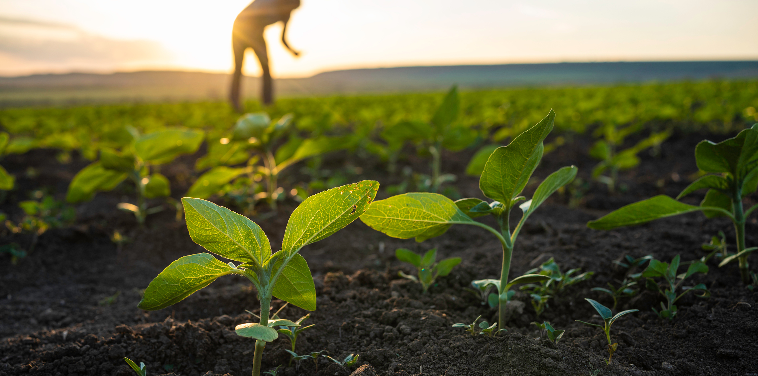


MARKET DAY: Bridging Farmers and Buyers in South Africa via a Native Mobile Platform
Team Members
Mncwili Adumodwa
Garidzira Tinashe Crispen
Sobetwa Siwaphiwe
Masangwana Siphelo
Boneka Ntanjana

Slide 2
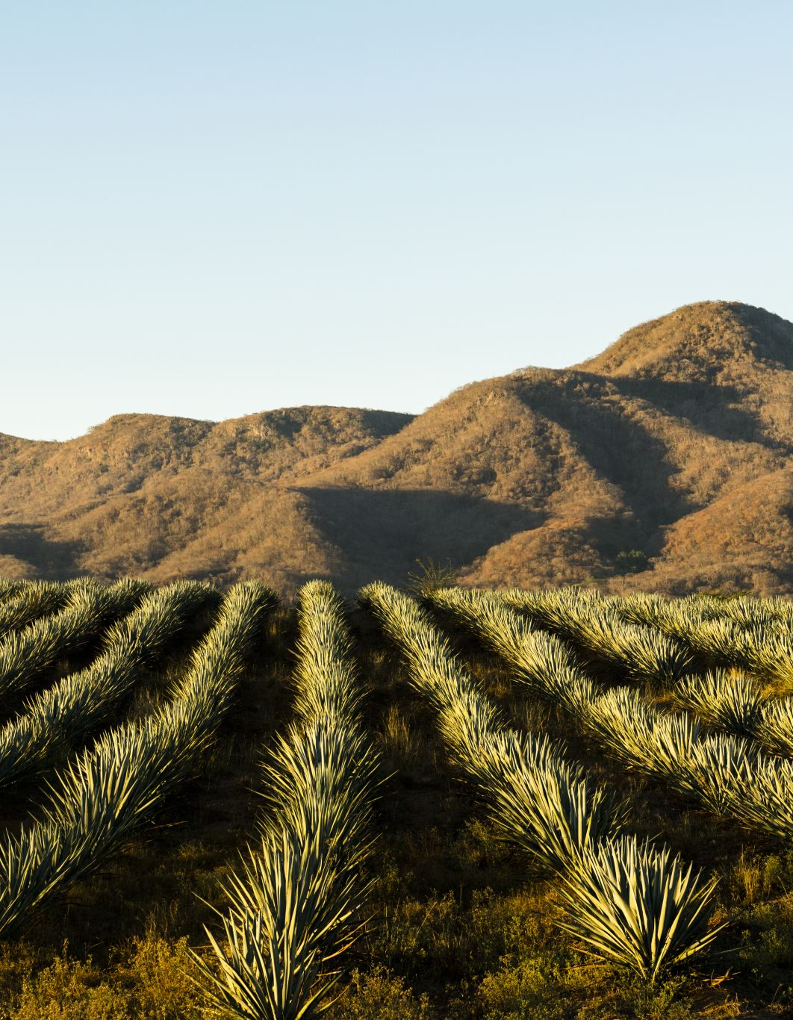
Problem Statement
Limited access to centralized agricultural markets is a major challenge for rural and smallholder farmers in South Africa.
Market days (e.g., Rosebank) are periodic and location-bound.
Farmers must travel long distances with high costs.
Buyers often struggle to find fresh, affordable produce consistently.

Slide 3
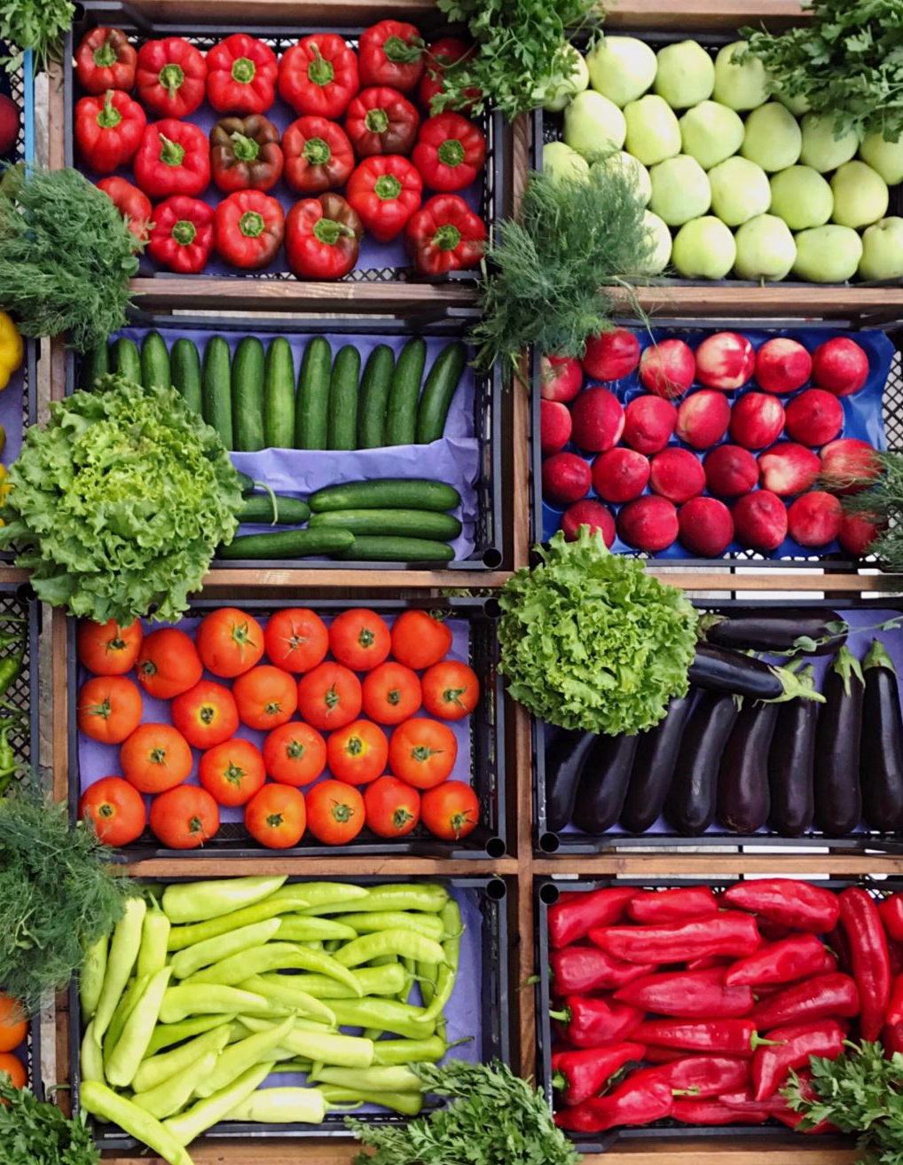
Our Solution
A mobile marketplace where farmers sell, and buyers purchase fresh produce - anytime, anywhere.
Native mobile app (React Native with Expo).
Features for produce listings, chat, and delivery.

Slide 4

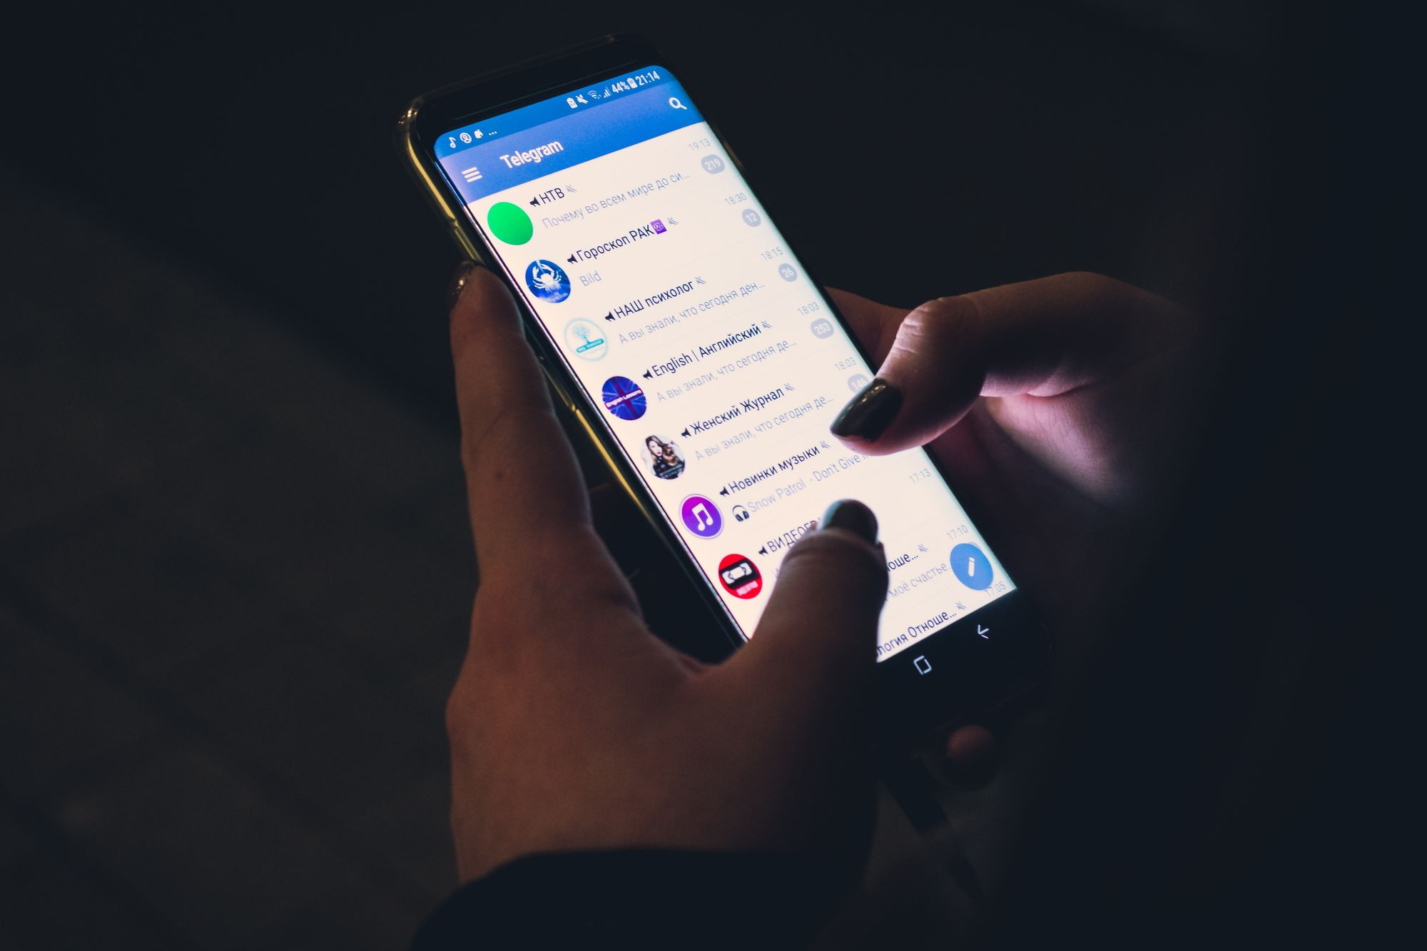
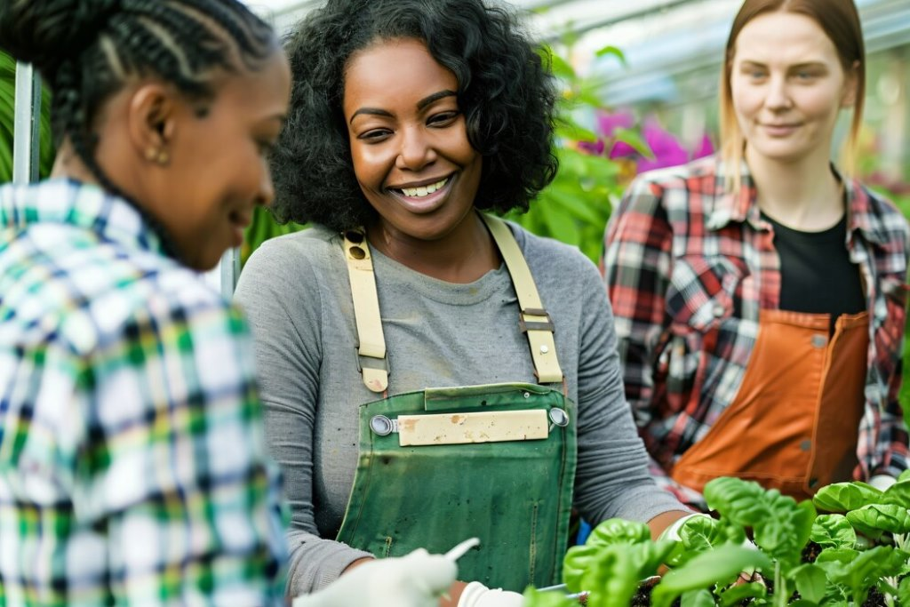


Key Features
Sell Products: Fresh produce, poultry, etc.
Buy Online: Browse listings by proximity or freshness.
Chat Messaging: Real-time communication between buyers & farmers.
Social Authentication: Google & Facebook via Clerk.
Multilingual Support: Local language accessibility (planned for future).
Recommentations intergrations with AI (recommendation algorithms)

Slide 5
Target Users
Smallholder Farmers: Seeking wider reach & better pricing.
Urban Buyers: Looking for fresh, local goods without market hassle.
Distributors & Restaurants: For bulk, consistent supply sourcing.

Slide 6






Technical Architecture
Frontend:
React Native (Expo) – Fast native development.
Backend & Database:
Convex (for real-time storage, syncing, and API routes).
Integrated chat for P2P messaging.
Auth & Login:
Clerk with Google & Facebook sign-in.
Other Tools:
Location API (for location-based listing ).
Push notifications (Expo).
Collaboration
GitHub

Slide 7
Hackathon Plan (5-Day Timeline)
Day | Focus
1 | Ideation, wireframes, backend setup, Clerk auth
2 | Product listing, Convex integration
3 | Buyer side, chat feature, farmer dashboard
4 | Delivery logic, polish UI
5 | Final testing, pitch prep & presentation

Slide 8
Expected Impact
Economic Inclusion: Empower rural producers.
Marketplace Efficiency: Direct sales, reduced waste.
Social Connection: Builds trust through real-time farmer-buyer chat.
Sustainable Consumption: Promotes local food economies.

Slide 9
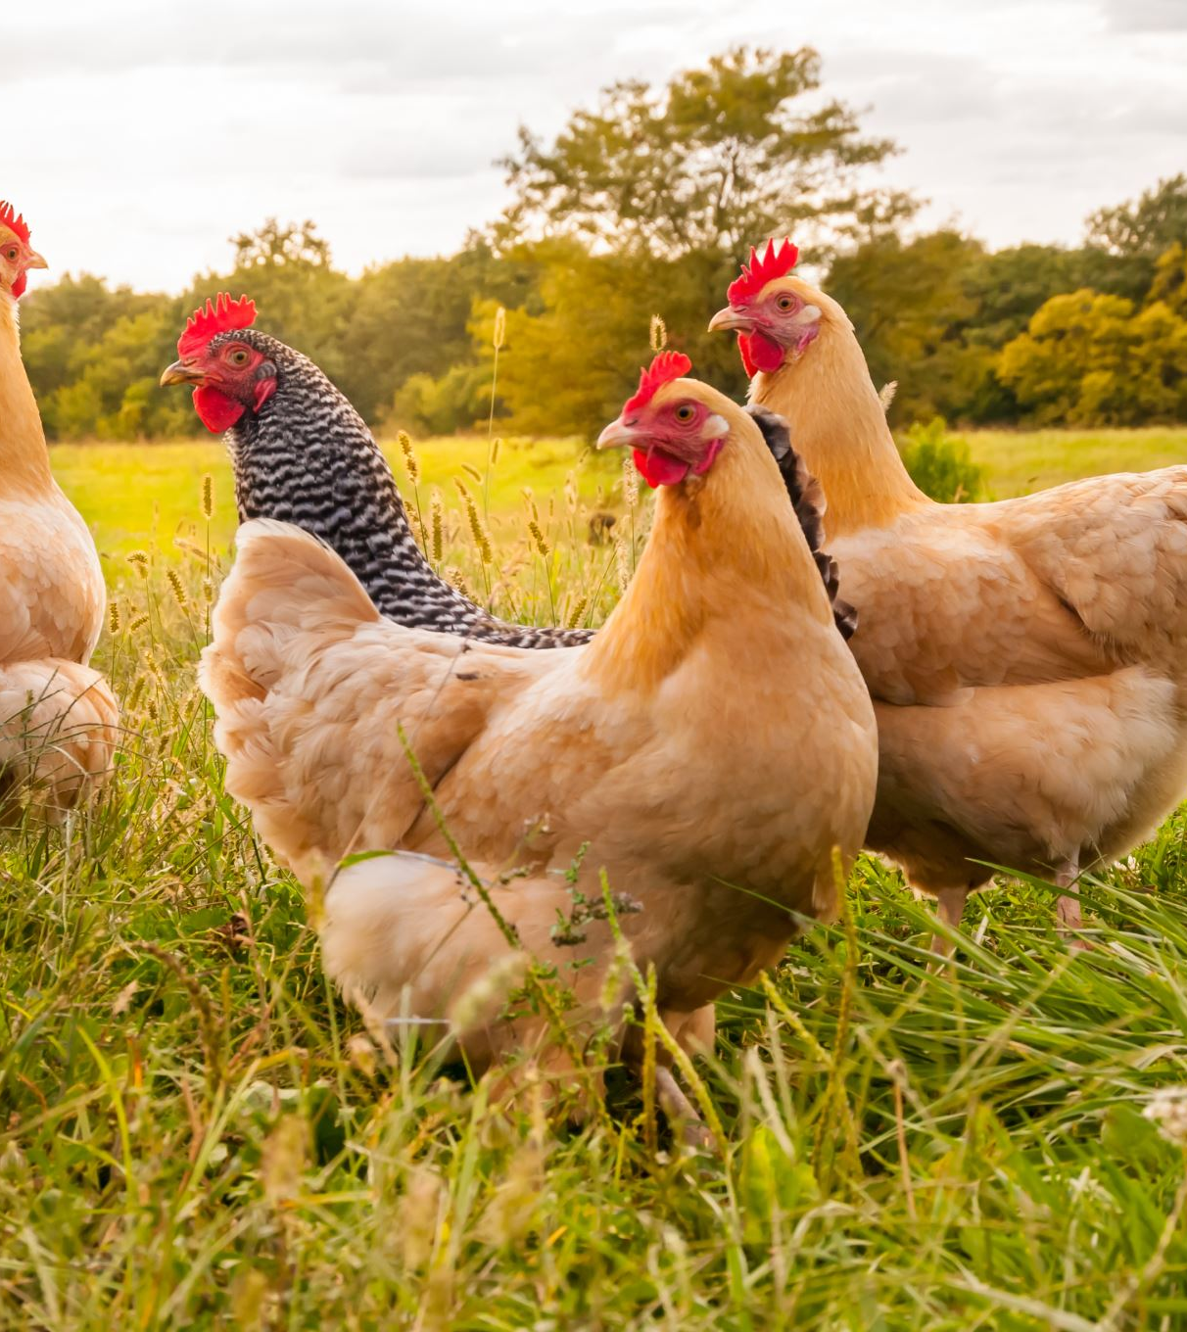
What Makes Us Different?
Real-time messaging directly between farmers.
Native mobile-first design for low-connectivity regions.
Support for poultry and perishable produce.
Clerk-based social login = Fast, secure onboarding.

Slide 10
Call to Action
“Let’s decentralize the market and empower local producers.”
Help us make "Market Day" a national tool for economic change.
Looking forward to your feedback and support!

Slide 11
References
Clerk.dev, 2024. Social Authentication Docs. [online] Available at: https://clerk.dev [Accessed 3 Jul. 2025].
Convex.dev, 2024. Realtime React Backend. [online] Available at: https://convex.dev [Accessed 3 Jul. 2025].
GSMA AgriTech, 2020. Digital Agriculture Maps 2020 State of the Sector. [online] Available at: https://www.gsma.com/solutions-and-impact/connectivity-for-good/mobile-for-development/uncategorized/introducing-digital-agriculture-maps-a-2020-state-of-the-sector-report/ [Accessed 3 Jul. 2025].
GSMA, 2022. The Mobile Economy Sub-Saharan Africa. [online] Available at: https://www.gsma.com [Accessed 3 Jul. 2025].
React Native, 2023. React Native Docs. [online] Available at: https://reactnative.dev [Accessed 3 Jul. 2025].
World Bank, 2019. Enabling the Business of Agriculture. Washington DC: World Bank. Available at: https://eba.worldbank.org/en/eba [Accessed 3 Jul. 2025].

Slide 12

Questions

